Slide 1
Project figures
2. METASTATIC SCORING

Slide 2
Metastatic scoring: cBioPortal
OVERVIEW
Notes:
General genes for invasion and metastasis - 27 gene
MMP1 MMP2 MMP3 MMP7 MMP9 MMP10 MMP11 MMP12 MMP13 MMP14
MMP15 MMP16 MMP17 MMP19 MMP21 MMP23B MMP24 MMP25 MMP26 MMP27
MMP28 ITGB3 ITGAV PTK2 CDH1 SPARC WFDC2

Slide 3
Notes:
103 samples
NA replaced by 0

Slide 4
Notes:
368 samples
NA changed to 0

Slide 5
Notes:
80 samples
NA changed to 0

Slide 6
Cohort 1 | Cohort 2 | Adjusted p
SKCM TP | SKCM TM | 4.13e-03
SKCM TP | UVM | 5.34e-09
SKCM TM | UVM | 2.91e-06
Notes:
ANOVA
Df Sum Sq Mean Sq F value Pr(>F)
cohort 2 18.53 9.266 18.82 1.25e-08 ***
Residuals 548 269.85 0.492
Primary, cells want to metastasize, starting to metast, in prep stage for metast
Once metastasized, they don’t want to much anymore, different state, no potential to further disseminate
split

Slide 7
Metastatic scoring: cBioPortal
STAGE
Notes:
General genes for invasion and metastasis - 27 gene
MMP1 MMP2 MMP3 MMP7 MMP9 MMP10 MMP11 MMP12 MMP13 MMP14
MMP15 MMP16 MMP17 MMP19 MMP21 MMP23B MMP24 MMP25 MMP26 MMP27
MMP28 ITGB3 ITGAV PTK2 CDH1 SPARC WFDC2

Slide 8
Notes:
ANOVA
Df Sum Sq Mean Sq F value Pr(>F)
stage 3 1.48 0.4934 1.016 0.389
Residuals 94 45.67 0.4858

Slide 9
Notes:
ANOVA
Df Sum Sq Mean Sq F value Pr(>F)
stage 3 1.42 0.4738 0.934 0.425
Residuals 305 154.80 0.5075

Slide 10
Notes:
SKCM TP
Welch Two Sample t-test
data: tp.skcm.metscore.stage.early$met_score and tp.skcm.metscore.stage.late$met_score
t = 0.36297, df = 55.404, p-value = 0.718
alternative hypothesis: true difference in means is not equal to 0
95 percent confidence interval: -0.2521300 0.3636851
sample estimates:
mean of x mean of y
7.742203 7.686425
SKCM TM
Welch Two Sample t-test
data: tm.skcm.metscore.stage.early$met_score and tm.skcm.metscore.stage.late$met_score
t = -1.5593, df = 297.01, p-value = 0.12
alternative hypothesis: true difference in means is not equal to 0
95 percent confidence interval: -0.28659202 0.03320864
sample estimates: mean of x mean of y
7.408543 7.535235

Slide 11
Notes:
ANOVA
Df Sum Sq Mean Sq F value Pr(>F)
stage 2 0.42 0.2093 0.486 0.617
Residuals 77 33.18 0.4308

Slide 12
Notes:
Welch Two Sample t-test
data: uvm.metscore.stage.early$met_score and uvm.metscore.stage.late$met_score
t = -0.41251, df = 77.99, p-value = 0.6811
alternative hypothesis: true difference in means is not equal to 0
95 percent confidence interval: -0.3473651 0.2281232
sample estimates:
mean of x mean of y
7.037893 7.097514

Slide 13
Metastatic scoring: Significantly differentially expressed genes SKCM TP vs. TM
OVERVIEW

Slide 14
Metastasis gene list selection
Upregulated in TM
42 genes
cBioportal and literature
119 genes
Differentially expressed
63 genes
Downregulated in TM
21 genes

Slide 15
Genes with significant difference in mean expression TP vs. TM
UPREGULATED IN TM (n = 42) | AKT3 | BRCA1 | BUB1 | C7 | CDK1 | CHEK1
 | DNA2 | DUP4 | DUP6 | EIF2AK3 | FPG7 | GFPT1
 | HIF1A | HMGA2 | HOXB9 | ITGAV | ITGB3 | MAD2L1
 | MAGEA1 | MAGEA5 | MCM6 | MMP9 | MMP12 | MSH2
 | MSH6 | NEDD9 | PEG10 | PGM3 | POLR3D | PRIM1
 | RFC4 | SEC23A | SEC23B | SEC25A | SEC24B | SEC24D
 | SMC2 | SMC4 | SPP1 | SPRED1 | UAP1 | UBE2W
DOWNREGULATED IN TM (n = 21) | AMDHD2 | CDH1 | CDK2 | GALK1 | GPR19 | GYPC
 | MAD2L1BP | MMP1 | MMP2 | MMP3 | MMP7 | MMP10
 | MMP11 | MMP13 | MMP14 | MMP17 | MMP24 | MMP27
 | MMP28 | RFC2 | RGS20 | UBE2S

Slide 16
Notes:
103 samples
NA replaced by 0

Slide 17
Notes:
103 samples
NA replaced by 0

Slide 19
$$\text{Metastatic} \text{potential} \text{score}= \frac{\text{Avg} \text{expression} \text{upregulated} \text{genes}}{\text{Avg} \text{expression} \text{downregulated} \text{genes}}$$

Slide 20
Notes:
Welch Two Sample t-test
data: tp.skcm.metscore$metscore and tm.skcm.metscore$metscore
t = -13.865, df = 166.12, p-value < 2.2e-16
alternative hypothesis: true difference in means is not equal to 0
95 percent confidence interval: -0.2473438 -0.1856824
sample estimates:
mean of x mean of y
1.037300 1.253814

Slide 21
Metastatic scoring: Significantly differentially expressed genes SKCM TP vs. TM
STAGE

Slide 22
Notes:
ANOVA
Df Sum Sq Mean Sq F value Pr(>F)
stage 3 0.0559 0.01863 0.933 0.428
Residuals 94 1.8771 0.01997

Slide 23
Notes:
ANOVA
Df Sum Sq Mean Sq F value Pr(>F)
stage 3 0.091 0.03017 1.493 0.216
Residuals 305 6.162 0.02021
Stage 1 , starting to dessiminate, stage 2 it’s been a while since dessiminated, stage4 been a long time alredy
Already metastasized so makes sense the potential went down

Slide 24
Notes:
TP
Welch Two Sample t-test
data: tp.skcm.metscore.stage.early$metscore and tp.skcm.metscore.stage.late$metscore
t = -1.234, df = 39.475, p-value = 0.2245
alternative hypothesis: true difference in means is not equal to 0
95 percent confidence interval: -0.11892006 0.02877817
sample estimates:
mean of x mean of y
1.023609 1.068680
TM
Welch Two Sample t-test
data: tm.skcm.metscore.stage.early$metscore and tm.skcm.metscore.stage.late$metscore
t = 1.4203, df = 302.73, p-value = 0.1565
alternative hypothesis: true difference in means is not equal to 0
95 percent confidence interval: -0.008881672 0.054963615
sample estimates:
mean of x mean of y
1.265079 1.242039
Look into why why overlap between score
Compare, start with quartiles (lower and upper) should be

Slide 25
Cutoff: 1.0 | Low potential | High potential
Early | 43 | 173
Late | 14 | 177
$$\text{Metastatic} \text{potential} \text{score}= \frac{\text{Avg} \text{expression} \text{upregulated} \text{genes}}{\text{Avg} \text{expression} \text{downregulated} \text{genes}}$$
Notes:
Fisher's Exact Test for Count Data
data: earlyLate_hilow
p-value = 0.0002919
alternative hypothesis: true odds ratio is not equal to 1
95 percent confidence interval: 1.612242 6.435686
sample estimates:
odds ratio 3.134123

Slide 26
DO NOT USE
Metastatic potential cutoff = 1.0
Notes:
ANOVA - Low potential Pairwise t-test - Low potential
Df Sum Sq Mean Sq F value Pr(>F) pval padj
stage 2 0.0318 0.015902 4.049 0.0247 * Stage I Stage II 0.0001337137 0.0004011411
Residuals 42 0.1650 0.003927 Stage I Stage III 0.0027086633 0.0040629949
Stage II Stage III 0.0532248916 0.0532248916
ANOVA - High potential
Df Sum Sq Mean Sq F value Pr(>F)
stage 2 0.0366 0.01829 1.454 0.243
Residuals 50 0.6293 0.01259

Slide 27
Metastatic scoring: UVM
OVERVIEW

Slide 28
Differentially expressed genes UVM
UPREGULATED (n = 5) | HTR2B | EM1 | RAB31 | CDH1
 | PRAME
DOWNREGULATED (n = 8) | FXR1 | LTA4H | EIF1B | ID2
 | ROBO1 | LMCD1 | SATB1 | MTUS1

Slide 30
SKCM Cutoff: 1.0 | Low potential | High potential
Early | 43 | 173
Late | 14 | 177
UVM Cutoff: 1.0 | Low potential | High potential
Early | 24 | 12
Late | 18 | 26
$$\text{Metastatic} \text{potential} \text{score}= \frac{\text{Avg} \text{expression} \text{upregulated} \text{genes}}{\text{Avg} \text{expression} \text{downregulated} \text{genes}}$$
Notes:
SKCM Fisher's Exact Test for Count Data
data: earlyLate_hilow
p-value = 0.0002919
alternative hypothesis: true odds ratio is not equal to 1
95 percent confidence interval: 1.612242 6.435686
sample estimates:
odds ratio 3.134123
UVM Fisher's Exact Test for Count Data
data: uvm_earlyLate_hilow
p-value = 0.02613
alternative hypothesis: true odds ratio is not equal to 1
95 percent confidence interval: 1.054398 8.037446
sample estimates:
odds ratio 2.84944

Slide 31
Metastatic potential vs. sigs
TOTAL MUTATION CONTRIBUTION

Slide 32
Notes:
1 outlier removed
Wilcoxon rank sum test with continuity correction
data: s7$S7[which(s7$met_potential == "low")] and s7$S7[which(s7$met_potential == "high")]
W = 953, p-value = 0.1171
alternative hypothesis: true location shift is not equal to 0

Slide 33
Notes:
Wilcoxon rank sum test with continuity correction
data: s1$S1[which(s1$met_potential == "low")] and s1$S1[which(s1$met_potential == "high")]
W = 989, p-value = 0.1475
alternative hypothesis: true location shift is not equal to 0

Slide 34
Notes:
Removed:
1 outlier
1 NaN
11 Inf → add 0.00001 to all values (to avoid dividing by 0)

Slide 35
Notes:
1 outlier removed

Slide 36
Notes:
1 outlier removed

Slide 38
Survival

Slide 39
Survival information by cohort
 | SKCM TP | SKCM TM
 | n = 104 | n = 363
Alive | 74 (71.2%) | 172 (47.4%)
Dead | 40 (28.8%) | 191 (52.6%)
Mean survival (days) | 500.8 | 1998.7
Survival (min – max) | 170 – 1354 | 79 – 10870

Slide 40
SKCM TP metastatic potential
Low | High
45 | 53
SKCM TM metastatic potential
Low | High
5 | 157
71 removed (missing survival data)
- High: 6
- Low: 21
Notes:
SKCM TP
Log rank test
Call: survdiff(formula = Surv(days_to_death, vital_status) ~ met_potential, data = tp.surv, rho = 0)
n=27, 71 observations deleted due to missingness.
N Observed Expected (O-E)^2/E (O-E)^2/V
met_potential=high 6 6 5.21 0.121 0.163
met_potential=low 21 21 21.79 0.029 0.163
Chisq= 0.2 on 1 degrees of freedom, p= 0.7
Wilcoxon test
Call: survdiff(formula = Surv(days_to_death, vital_status) ~ met_potential, data = tp.surv, rho = 1)
n=27, 71 observations deleted due to missingness.
N Observed Expected (O-E)^2/E (O-E)^2/V
met_potential=high 6 2.89 3.33 0.0593 0.112
met_potential=low 21 11.15 10.70 0.0185 0.112
Chisq= 0.1 on 1 degrees of freedom, p= 0.7
SKCM TM
Log rank test
Call: survdiff(formula = Surv(days_to_death, vital_status) ~ met_potential, data = tm.surv, rho = 0)
N Observed Expected (O-E)^2/E (O-E)^2/V
met_potential=high 157 157 157.36 0.000834 0.0294
met_potential=low 5 5 4.64 0.028309 0.0294
Chisq= 0 on 1 degrees of freedom, p= 0.9
Wilcoxon test
Call: survdiff(formula = Surv(days_to_death, vital_status) ~ met_potential, data = tm.surv, rho = 1)
N Observed Expected (O-E)^2/E (O-E)^2/V
met_potential=high 157 78.68 79.3 0.0049 0.268
met_potential=low 5 2.83 2.2 0.1764 0.268
Chisq= 0.3 on 1 degrees of freedom, p= 0.6

Slide 41
KM plot SKCM TP survival by met potential
 | Metastatic potential
 | Low | High
 | 45 | 53
Missing survival data | 24 | 47
Notes:
Log rank test
Call: survdiff(formula = Surv(days_to_death, vital_status) ~ met_potential, data = tp.surv, rho = 0)
n=27, 71 observations deleted due to missingness.
N Observed Expected (O-E)^2/E (O-E)^2/V
met_potential=high 6 6 5.21 0.121 0.163
met_potential=low 21 21 21.79 0.029 0.163
Chisq= 0.2 on 1 degrees of freedom, p= 0.7
Wilcoxon test
Call: survdiff(formula = Surv(days_to_death, vital_status) ~ met_potential, data = tp.surv, rho = 1)
n=27, 71 observations deleted due to missingness.
N Observed Expected (O-E)^2/E (O-E)^2/V
met_potential=high 6 2.89 3.33 0.0593 0.112
met_potential=low 21 11.15 10.70 0.0185 0.112
Chisq= 0.1 on 1 degrees of freedom, p= 0.7

Slide 42
KM plot SKCM TP survival by met potential quant
SKCM TP metastatic potential
Low | High
25 | 25
71 removed (missing survival data)
- High: 2
- Low: 12
Notes:
Log rank test
Call: survdiff(formula = Surv(days_to_death, vital_status) ~ met_potential_quant, data = tp.surv.quant, rho = 0)
n=14, 36 observations deleted due to missingness.
N Observed Expected (O-E)^2/E (O-E)^2/V
met_potential_quant=high 2 2 1.39 0.2668 0.317
met_potential_quant=low 12 12 12.61 0.0294 0.317
Chisq= 0.3 on 1 degrees of freedom, p= 0.573
Wilcoxon test
Call: survdiff(formula = Surv(days_to_death, vital_status) ~ met_potential_quant, data = tp.surv.quant, rho = 1)
n=14, 36 observations deleted due to missingness.
N Observed Expected (O-E)^2/E (O-E)^2/V
met_potential_quant=high 2 1.14 1.0 0.02041 0.0317
met_potential_quant=low 12 6.36 6.5 0.00314 0.0317
Chisq= 0 on 1 degrees of freedom, p= 0.859

Slide 43
CoxPH model – SKCM stage
Primary tumors (TP)
Metastatic tumors (TM)
Call:
coxph(formula = Surv(days_to_death, vital_status) ~ stage, data = tp.surv)
n= 27, number of events= 27 (71 observations deleted due to missingness)
coef exp(coef) se(coef) z Pr(>|z|)
stageIII 2.0840 8.0367 0.5796 3.596 0.000323 ***
--- Signif. codes: 0 ‘***’ 0.001 ‘**’ 0.01 ‘*’ 0.05 ‘.’ 0.1 ‘ ’ 1
exp(coef) exp(-coef) lower .95 upper .95
stageIII 8.037 0.1244 2.581 25.03
Concordance= 0.649 (se = 0.036 )
Rsquare= 0.333 (max possible= 0.992 )
Likelihood ratio test = 10.95 on 1 df, p=9e-04
Wald test = 12.93 on 1 df, p=3e-04
Score (logrank) test = 17.46 on 1 df, p=3e-05
Call:
coxph(formula = Surv(days_to_death, vital_status) ~ stage, data = tm.surv)
n= 162, number of events= 162
coef exp(coef) se(coef) z Pr(>|z|)
stageII -0.09491 0.90946 0.23578 -0.403 0.687
stageIII -0.18812 0.82852 0.20158 -0.933 0.351
stageIV -0.15842 0.85349 0.33298 -0.476 0.634
exp(coef) exp(-coef) lower .95 upper .95
stageII 0.9095 1.100 0.5729 1.444
stageIII 0.8285 1.207 0.5581 1.230
stageIV 0.8535 1.172 0.4444 1.639
Concordance= 0.52 (se = 0.025 )
Rsquare= 0.006 (max possible= 1 )
Likelihood ratio test= 0.9 on 3 df, p=0.8
Wald test = 0.92 on 3 df, p=0.8
Score (logrank) test = 0.92 on 3 df, p=0.8
Notes:
Look at HR only, not coeff, so here Stage III has 8-fold increase in risk of death compared to stage II

Slide 44
CoxPH model – SKCM main mutsigs
Primary tumors (TP)
Metastatic tumors (TM)
Call:
coxph(formula = Surv(days_to_death, vital_status) ~ S7 + S1 + S11 + S23 + S6, data = tm.surv)
n= 162, number of events= 162
coef exp(coef) se(coef) z Pr(>|z|)
S7 -0.6003 0.5487 0.4395 -1.366 0.1720
S1 1.0300 2.8011 1.0285 1.001 0.3166
S11 0.6647 1.9440 1.6583 0.401 0.6885
S23 2.7102 15.0322 1.6903 1.603 0.1089
S6 5.5693 262.2631 2.3149 2.406 0.0161 *
--- Signif. codes: 0 ‘***’ 0.001 ‘**’ 0.01 ‘*’ 0.05 ‘.’ 0.1 ‘ ’ 1
exp(coef) exp(-coef) lower .95 upper .95
S7 0.5487 1.822582 0.23185 1.298
S1 2.8011 0.356997 0.37311 21.030
S11 1.9440 0.514408 0.07537 50.142
S23 15.0322 0.066524 0.54730 412.875
S6 262.2631 0.003813 2.80755 24498.923
Concordance= 0.566 (se = 0.026 )
Rsquare= 0.096 (max possible= 1 )
Likelihood ratio test= 16.35 on 5 df, p=0.006
Wald test = 18.78 on 5 df, p=0.002
Score (logrank) test = 19.41 on 5 df, p=0.002
Call:
coxph(formula = Surv(days_to_death, vital_status) ~ S7 + S1 + S11 + S23 + S6, data = tp.surv)
n= 27, number of events= 27
(71 observations deleted due to missingness)
coef exp(coef) se(coef) z Pr(>|z|)
S7 -1.56114 0.20990 1.17105 -1.333 0.182
S1 -2.19545 0.11131 2.55383 -0.860 0.390
S11 3.49605 32.98488 3.79008 0.922 0.356
S23 6.82498 920.55788 4.65224 1.467 0.142
S6 -2.57223 0.07637 3.05923 -0.841 0.400
exp(coef) exp(-coef) lower .95 upper .95
S7 0.20990 4.764236 0.0211451 2.084e+00
S1 0.11131 8.984054 0.0007459 1.661e+01
S11 32.98488 0.030317 0.0195973 5.552e+04
S23 920.55788 0.001086 0.1009392 8.395e+06
S6 0.07637 13.094950 0.0001901 3.068e+01
Concordance= 0.646 (se = 0.069 )
Rsquare= 0.189 (max possible= 0.992 )
Likelihood ratio test = 5.65 on 5 df, p=0.3
Wald test = 5.66 on 5 df, p=0.3
Score (logrank) test = 6.01 on 5 df, p=0.3

Slide 45
CoxPH model – SKCM TM treatment
coxph(formula = Surv(days_to_death, vital_status) ~ treatment, data = tm.surv)
n= 21, number of events= 21
(141 observations deleted due to missingness)
coef exp(coef) se(coef) z Pr(>|z|)
treatmentinterferon -2.20974 0.10973 1.24340 -1.777 0.0755 .
treatmentinterferon + radiation -1.95644 0.14136 1.33076 -1.470 0.1415
treatmentradiation -2.52564 0.08001 1.28509 -1.965 0.0494 *
--- Signif. codes: 0 ‘***’ 0.001 ‘**’ 0.01 ‘*’ 0.05 ‘.’ 0.1 ‘ ’ 1
exp(coef) exp(-coef) lower .95 upper .95
treatmentinterferon 0.10973 9.113 0.009593 1.2552
treatmentinterferon + radiation 0.14136 7.074 0.010413 1.9190
treatmentradiation 0.08001 12.499 0.006446 0.9931
Concordance= 0.545 (se = 0.072 )
Rsquare= 0.135 (max possible= 0.987 )
Likelihood ratio test = 3.04 on 3 df, p=0.4
Wald test = 3.97 on 3 df, p=0.3
Score (logrank) test = 5.69 on 3 df, p=0.1

Slide 46
CoxPH model – SKCM TM radiation
Call:
coxph(formula = Surv(days_to_death, vital_status) ~ radiation_therapy, data = tm.surv)
n= 162, number of events= 162
coef exp(coef) se(coef) z Pr(>|z|)
radiation_therapy -0.1141 0.8922 0.3279 -0.348 0.728
exp(coef) exp(-coef) lower .95 upper .95
radiation_therapy 0.8922 1.121 0.4692 1.697
Concordance= 0.508 (se = 0.011 )
Rsquare= 0.001 (max possible= 1 )
Likelihood ratio test = 0.13 on 1 df, p=0.7
Wald test = 0.12 on 1 df, p=0.7
Score (logrank) test = 0.12 on 1 df, p=0.7

Slide 47
CoxPH model – SKCM TM treatment, mutsigs, …
Call:
coxph(formula = Surv(days_to_death, vital_status) ~ treatment + S7 + S1 + S11 + S23 + S6 + gender + stage + earlyLate + metscore + met_potential, data = tm.surv)
n= 21, number of events= 21
(141 observations deleted due to missingness)
coef exp(coef) se(coef) z Pr(>|z|)
treatmentinterferon -3.473e+00 3.101e-02 1.722e+00 -2.018 0.0436 *
treatmentinterferon + radiation -3.557e+00 2.853e-02 1.874e+00 -1.898 0.0577 .
treatmentradiation -4.501e+00 1.110e-02 2.070e+00 -2.174 0.0297 *
S7 -3.543e+00 2.892e-02 1.612e+00 -2.197 0.0280 *
S1 -1.684e+00 1.856e-01 3.533e+00 -0.477 0.6335
S11 -4.400e+00 1.228e-02 6.847e+00 -0.643 0.5205
S23 -1.885e+00 1.518e-01 6.119e+00 -0.308 0.7580
S6 1.949e+01 2.903e+08 8.139e+00 2.394 0.0167 *
gendermale -4.655e-01 6.278e-01 9.641e-01 -0.483 0.6292
stageII -1.267e+00 2.817e-01 1.166e+00 -1.087 0.2771
stageIII 2.001e+00 7.394e+00 1.223e+00 1.635 0.1020
earlyLatelate NA NA 0.000e+00 NA NA
metscore 2.459e+00 1.170e+01 4.678e+00 0.526 0.5991
met_potential NA NA 0.000e+00 NA NA
--- Signif. codes: 0 ‘***’ 0.001 ‘**’ 0.01 ‘*’ 0.05 ‘.’ 0.1 ‘ ’ 1
exp(coef) exp(-coef) lower .95 upper .95
treatmentinterferon 3.101e-02 3.224e+01 1.062e-03 9.055e-01
treatmentinterferon + radiation 2.853e-02 3.505e+01 7.249e-04 1.123e+00
treatmentradiation 1.110e-02 9.011e+01 1.918e-04 6.421e-01
S7 2.892e-02 3.457e+01 1.227e-03 6.819e-01
S1 1.856e-01 5.389e+00 1.826e-04 1.885e+02
S11 1.228e-02 8.144e+01 1.824e-08 8.265e+03
S23 1.518e-01 6.586e+00 9.394e-07 2.454e+04
S6 2.903e+08 3.445e-09 3.424e+01 2.461e+15
gendermale 6.278e-01 1.593e+00 9.489e-02 4.154e+00
stageII 2.817e-01 3.550e+00 2.867e-02 2.767e+00
stageIII 7.394e+00 1.352e-01 6.724e-01 8.132e+01
earlyLatelate NA NA NA NA
metscore 1.170e+01 8.550e-02 1.218e-03 1.123e+05
met_potential NA NA NA NA
Concordance= 0.805 (se = 0.079 )
Rsquare= 0.634 (max possible= 0.987 )
Likelihood ratio test = 21.13 on 12 df, p=0.05
Wald test = 15.02 on 12 df, p=0.2
Score (logrank) test = 26.4 on 12 df, p=0.009

Slide 48
CoxPH model – SKCM TM treatment, mutsigs (cont.)
Call:
coxph(formula = Surv(days_to_death, vital_status) ~ treatment + S7 + S6, data = tm.surv)
n= 21, number of events= 21 (141 observations deleted due to missingness)
coef exp(coef) se(coef) z Pr(>|z|)
treatmentinterferon -3.625e+00 2.666e-02 1.440e+00 -2.517 0.01182 *
treatmentinterferon + radiation -2.882e+00 5.602e-02 1.462e+00 -1.972 0.04863 *
treatmentradiation -4.981e+00 6.867e-03 1.710e+00 -2.913 0.00358 **
S7 -2.763e+00 6.310e-02 1.049e+00 -2.635 0.00842 **
S6 1.206e+01 1.730e+05 5.313e+00 2.270 0.02321 *
--- Signif. codes: 0 ‘***’ 0.001 ‘**’ 0.01 ‘*’ 0.05 ‘.’ 0.1 ‘ ’ 1
exp(coef) exp(-coef) lower .95 upper .95
treatmentinterferon 2.666e-02 3.751e+01 0.0015862 4.482e-01
treatmentinterferon + radiation 5.602e-02 1.785e+01 0.0031938 9.828e-01
treatmentradiation 6.867e-03 1.456e+02 0.0002406 1.960e-01
S7 6.310e-02 1.585e+01 0.0080796 4.928e-01
S6 1.730e+05 5.782e-06 5.1934019 5.760e+09
Concordance= 0.681 (se = 0.079 )
Rsquare= 0.423 (max possible= 0.987 )
Likelihood ratio test = 11.55 on 5 df, p=0.04
Wald test = 10.37 on 5 df, p=0.07
Score (logrank) test = 13.77 on 5 df, p=0.02

Slide 49
CoxPH model – SKCM TP mutsigs…
Call:
coxph(formula = Surv(days_to_death, vital_status) ~ S7 + S1 + S11 + S23 + S6 + gender + stage + earlyLate + metscore + met_potential, data = tp.surv)
n= 27, number of events= 27 (71 observations deleted due to missingness)
coef exp(coef) se(coef) z Pr(>|z|)
S7 -1.974e+00 1.389e-01 1.483e+00 -1.331 0.18311
S1 -1.231e+00 2.920e-01 3.404e+00 -0.362 0.71762
S11 9.138e+00 9.305e+03 4.421e+00 2.067 0.03871 *
S23 1.785e+01 5.629e+07 7.845e+00 2.275 0.02292 *
S6 -4.882e+00 7.581e-03 3.879e+00 -1.259 0.20814
gendermale -5.100e-01 6.005e-01 5.260e-01 -0.970 0.33222
stageIII 2.115e+00 8.293e+00 7.332e-01 2.885 0.00391 **
earlyLatelate NA NA 0.000e+00 NA NA
metscore -1.073e+01 2.194e-05 6.647e+00 -1.614 0.10654
met_potentiallow -2.758e+00 6.343e-02 1.499e+00 -1.839 0.06587 .
--- Signif. codes: 0 ‘***’ 0.001 ‘**’ 0.01 ‘*’ 0.05 ‘.’ 0.1 ‘ ’ 1
exp(coef) exp(-coef) lower .95 upper .95
S7 1.389e-01 7.201e+00 7.592e-03 2.540e+00
S1 2.920e-01 3.424e+00 3.699e-04 2.305e+02
S11 9.305e+03 1.075e-04 1.607e+00 5.390e+07
S23 5.629e+07 1.777e-08 1.182e+01 2.680e+14
S6 7.581e-03 1.319e+02 3.786e-06 1.518e+01
gendermale 6.005e-01 1.665e+00 2.142e-01 1.684e+00
stageIII 8.293e+00 1.206e-01 1.971e+00 3.490e+01
earlyLatelate NA NA NA NA
metscore 2.194e-05 4.559e+04 4.825e-11 9.972e+00
met_potentiallow 6.343e-02 1.577e+01 3.357e-03 1.198e+00
Concordance= 0.783 (se = 0.069 )
Rsquare= 0.576 (max possible= 0.992 )
Likelihood ratio test = 23.17 on 9 df, p=0.006
Wald test = 19.46 on 9 df, p=0.02
Score (logrank) test = 27.26 on 9 df, p=0.001

Slide 50
CoxPH model – SKCM TP mutsigs and stage
Call:
coxph(formula = Surv(days_to_death, vital_status) ~ S11 + S23 + stage, data = tp.surv)
n= 27, number of events= 27 (71 observations deleted due to missingness)
coef exp(coef) se(coef) z Pr(>|z|)
S11 6.545e+00 6.957e+02 3.240e+00 2.020 0.043377 *
S23 1.086e+01 5.219e+04 4.802e+00 2.262 0.023690 *
stageIII 2.519e+00 1.241e+01 6.546e-01 3.848 0.000119 ***
--- Signif. codes: 0 ‘***’ 0.001 ‘**’ 0.01 ‘*’ 0.05 ‘.’ 0.1 ‘ ’ 1
exp(coef) exp(-coef) lower .95 upper .95
S11 695.70 1.437e-03 1.215 3.984e+05
S23 52192.64 1.916e-05 4.267 6.384e+08
stageIII 12.41 8.055e-02 3.441 4.478e+01
Concordance= 0.729 (se = 0.068 )
Rsquare= 0.476 (max possible= 0.992 )
Likelihood ratio test = 17.46 on 3 df, p=6e-04
Wald test = 16.44 on 3 df, p=9e-04
Score (logrank) test = 22.92 on 3 df, p=4e-05

Slide 51
KM plot SKCM TP survival by met potential censored
SKCM TP metastatic potential
Low | High
45 | 53
Replaced missing survival with max survival in cohort (1070 days)
Notes:
Prob not use unless looks better after correcting for treatment
Log rank test
Call: survdiff(formula = Surv(surv_cens, vital_status) ~ met_potential, data = tp.surv, rho = 0)
N Observed Expected (O-E)^2/E (O-E)^2/V
met_potential=high 53 6 16.1 6.29 15.6
met_potential=low 45 21 10.9 9.23 15.6
Chisq= 15.6 on 1 degrees of freedom, p= 7.86e-05
Wilcoxon test
Call: survdiff(formula = Surv(surv_cens, vital_status) ~ met_potential, data = tp.surv, rho = 1)
N Observed Expected (O-E)^2/E (O-E)^2/V
met_potential=high 53 5.14 13.87 5.49 15.4
met_potential=low 45 18.29 9.56 7.96 15.4
Chisq= 15.4 on 1 degrees of freedom, p= 8.66e-05
could have confounders
Run models again with treatment
could be inflating survival rate of high metpot
→ Not enough data in non-fixed cohort, couldn’t see sig diff

Slide 52
KM plot SKCM TP survival by met potential quantile censored
SKCM TP metastatic potential
Low | High
25 | 25
Replaced missing survival with max survival in cohort (1070 days)
Notes:
Log rank test
Call: survdiff(formula = Surv(surv_cens, vital_status) ~ met_potential_quant, data = tp.surv.quant, rho = 0)
N Observed Expected (O-E)^2/E (O-E)^2/V
met_potential_quant=high 25 2 7.77 4.28 9.66
met_potential_quant=low 25 12 6.23 5.34 9.66
Chisq= 9.7 on 1 degrees of freedom, p= 0.00188
Wilcoxon test
Call: survdiff(formula = Surv(surv_cens, vital_status) ~ met_potential_quant, data = tp.surv.quant, rho = 1)
N Observed Expected (O-E)^2/E (O-E)^2/V
met_potential_quant=high 25 1.76 6.72 3.66 9.34
met_potential_quant=low 25 10.42 5.46 4.51 9.34
Chisq= 9.3 on 1 degrees of freedom, p= 0.00225

Slide 53
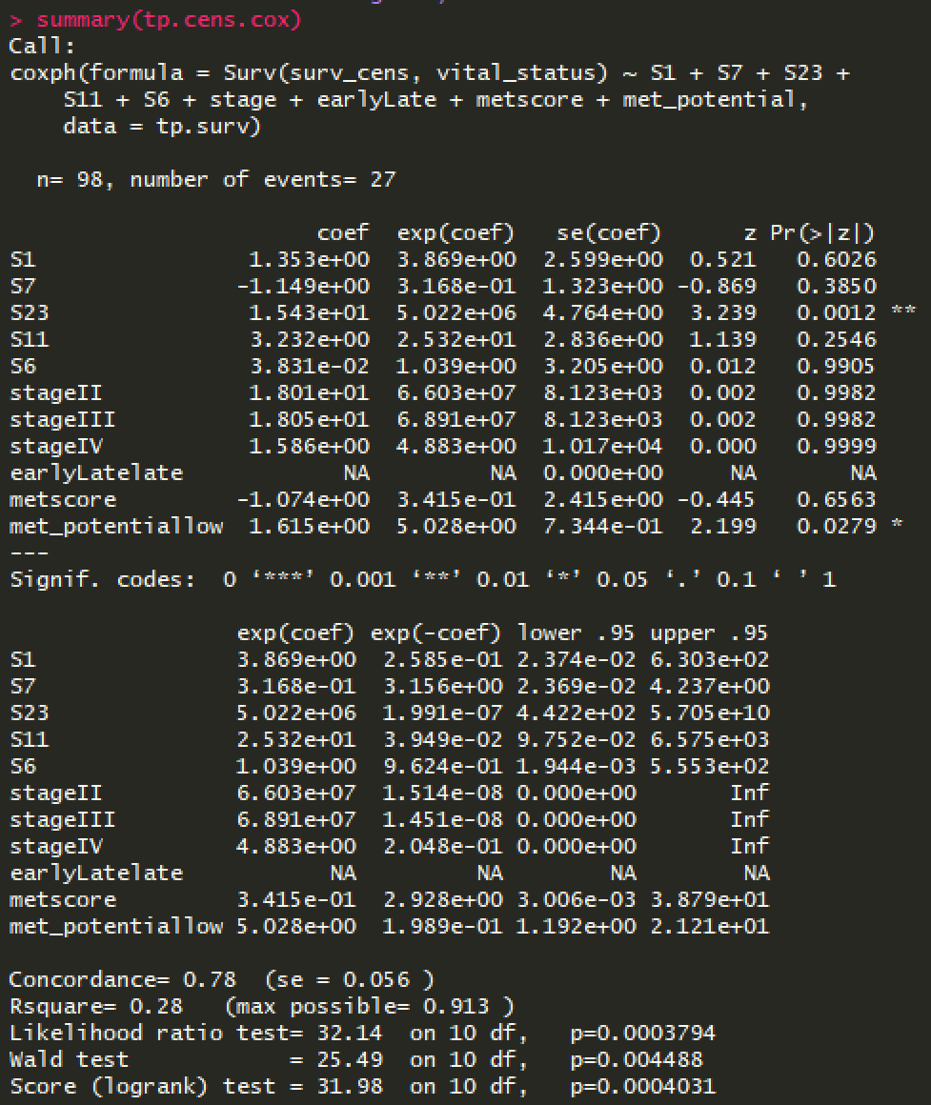
CoxPH model -- SKCM TP cens

Slide 54
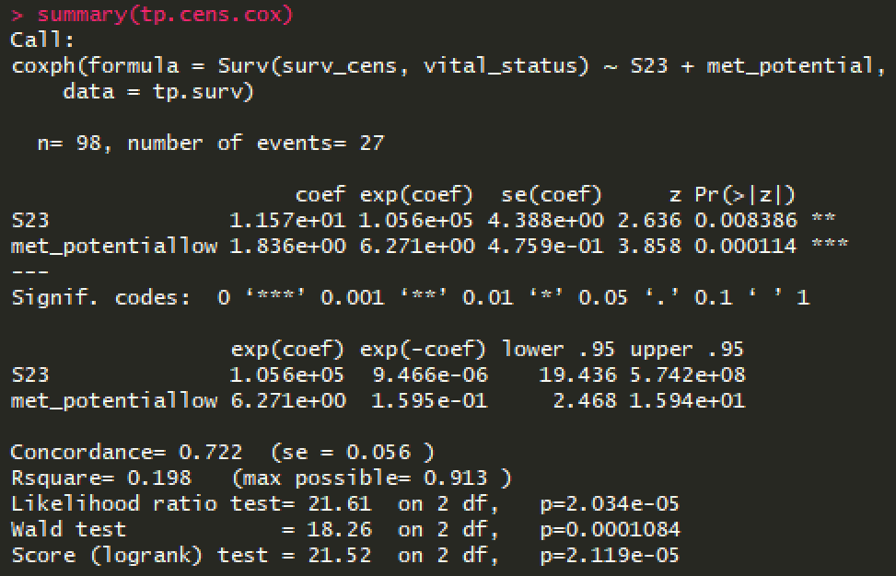
CoxPH model -- SKCM TP cens (cont.)
Vital status
1: dead
0: alive

Slide 55
KM survival UVM

Slide 56
KM plot UVM TP survival by met potential
 | Metastatic potential
 | Low | High
 | 42 | 38
Missing survival data | 38 | 19
Likelihood ratio test p=0.0354
Notes:
Log rank test

Slide 57
SKCM BRAF mutations
SKCM TP

Slide 58
BRAF distribution in cohort
 | SKCM TP | SKCM TM
 | n = 98 | n = 309
BRAF WT | 25 (25.5%) | 117 (37.9%)
BRAF mut | 34 (34.7%) | 120 (38.8%)
NA | 39 (39.8%) | 72 (23.3%)
Notes:
worth running in TM as well

Slide 59
TP BRAF WT – S7 vs. metscore
Notes:
Wilcoxon rank sum test with continuity correction
data: wt.s7[which(mut.s7$met_potential == "low"), 8] and wt.s7[which(mut.s7$met_potential == "high"), 8]
W = 68, p-value = 0.8617
alternative hypothesis: true location shift is not equal to 0

Slide 60
TP BRAF mut – S7 vs. metscore
Notes:
Wilcoxon rank sum test with continuity correction
data: mut.s7[which(mut.s7$met_potential == "low"), 8] and mut.s7[which(mut.s7$met_potential == "high"), 8]
W = 114, p-value = 0.6621
alternative hypothesis: true location shift is not equal to 0

Slide 61
TP S7/BRAF WT vs. mut
Notes:
Braf mut drives cancer progression, but in absence of mut S7 drives stronger metpot

Slide 62
TP BRAF wt – S1 vs. metscore
Notes:
Wilcoxon rank sum test with continuity correction
data: wt.s1[which(wt.s1$met_potential == "low"), 2] and wt.s1[which(wt.s1$met_potential == "high"), 2]
W = 47, p-value = 0.106
alternative hypothesis: true location shift is not equal to 0

Slide 63
TP BRAF mut – S1 vs. metscore
Notes:
Wilcoxon rank sum test with continuity correction
data: mut.s1[which(mut.s1$met_potential == "low"), 2] and mut.s1[which(mut.s1$met_potential == "high"), 2]
W = 108, p-value = 0.2353
alternative hypothesis: true location shift is not equal to 0

Slide 64
TP S1/BRAF WT vs. mut

Slide 65
TP BRAF wt – S11 vs. metscore
Notes:
Wilcoxon rank sum test with continuity correction
data: wt.s11[which(wt.s11$met_potential == "low"), 12] and wt.s11[which(wt.s11$met_potential == "high"), 12]
W = 75, p-value = 0.8287
alternative hypothesis: true location shift is not equal to 0

Slide 66
TP BRAF mut – S11 vs. metscore
Notes:
Wilcoxon rank sum test with continuity correction
data: mut.s11[which(mut.s11$met_potential == "low"), 12] and mut.s11[which(mut.s11$met_potential == "high"), 12]
W = 145, p-value = 0.9368
alternative hypothesis: true location shift is not equal to 0

Slide 67
TP S11/BRAF WT vs. mut

Slide 68
SKCM BRAF mutations
SKCM TM

Slide 69
TM BRAF wt – S7 vs. metscore
Notes:
Wilcoxon rank sum test with continuity correction
data: wt.s7[which(wt.s7$met_potential == "low"), 8] and wt.s7[which(wt.s7$met_potential == "high"), 8]
W = 248, p-value = 0.6711
alternative hypothesis: true location shift is not equal to 0

Slide 70
TM BRAF mut – S7 vs. metscore
Notes:
Wilcoxon rank sum test with continuity correction
data: mut.s7[which(mut.s7$met_potential == "low"), 8] and mut.s7[which(mut.s7$met_potential == "high"), 8]
W = 163, p-value = 0.8587
alternative hypothesis: true location shift is not equal to 0

Slide 71
TM S7/BRAF WT vs. mut

Slide 72
TM BRAF wt – S1 vs. metscore
Notes:
Wilcoxon rank sum test with continuity correction
data: wt.s1[which(wt.s1$met_potential == "low"), 2] and wt.s1[which(wt.s1$met_potential == "high"), 2]
W = 273, p-value = 0.9301
alternative hypothesis: true location shift is not equal to 0

Slide 73
TM BRAF mut – S1 vs. metscore
Notes:
Wilcoxon rank sum test with continuity correction
data: mut.s1[which(mut.s1$met_potential == "low"), 2] and mut.s1[which(mut.s1$met_potential == "high"), 2]
W = 205, p-value = 0.6256
alternative hypothesis: true location shift is not equal to 0

Slide 74
TM S1/BRAF WT vs. mut

Slide 75
TM BRAF wt – S11 vs. metscore
Notes:
Wilcoxon rank sum test with continuity correction
data: wt.s11[which(wt.s11$met_potential == "low"), 12] and wt.s11[which(wt.s11$met_potential == "high"), 12]
W = 260, p-value = 0.7541
alternative hypothesis: true location shift is not equal to 0

Slide 76
TM BRAF mut – S11 vs. metscore
Notes:
Wilcoxon rank sum test with continuity correction
data: mut.s11[which(mut.s11$met_potential == "low"), 12] and mut.s11[which(mut.s11$met_potential == "high"), 12]
W = 170, p-value = 0.9281
alternative hypothesis: true location shift is not equal to 0

Slide 77
TM S11/BRAF WT vs. mut

Slide 78
Schwann cell markers
CORRELATION WITH METSCORE

Slide 79
X-axis:
add log2()
Notes:
Outliers removed (< 25%, >75% percentile gene expression)

Slide 80
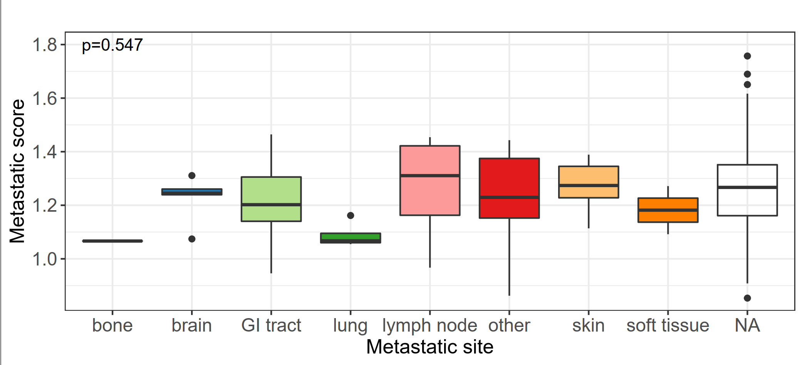
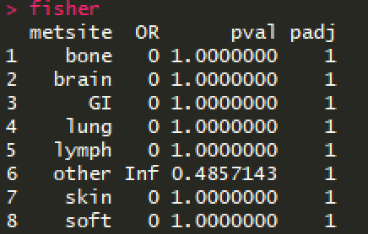
Metastatic site

Slide 81
Nucleotide excision repair

Slide 82
Signature | Description
4 | Signature 4 exhibits transcriptional strand bias for C>A mutations, compatible with the notion that damage to guanine is repaired by transcription-coupled nucleotide excision repair. Signature 4 is also associated with CC>AA dinucleotide substitutions.
7 | Signature 7 is associated with large numbers of CC>TT dinucleotide mutations at dipyrimidines. Additionally, Signature 7 exhibits a strong transcriptional strand-bias indicating that mutations occur at pyrimidines (viz., by formation of pyrimidine-pyrimidine photodimers) and these mutations are being repaired by transcription-coupled nucleotide excision repair.
11 | Signature 11 exhibits a strong transcriptional strand-bias for C>T substitutions indicating that mutations occur on guanine and that these mutations are effectively repaired by transcription-coupled nucleotide excision repair.
22 | Signature 22 exhibits a very strong transcriptional strand bias for T>A mutations indicating adenine damage that is being repaired by transcription-coupled nucleotide excision repair.
23 | Signature 23 exhibits very strong transcriptional strand bias for C>T mutations.
24 | Signature 24 exhibits a very strong transcriptional strand bias for C>A mutations indicating guanine damage that is being repaired by transcription-coupled nucleotide excision repair.
29 | Signature 29 exhibits transcriptional strand bias for C>A mutations indicating guanine damage that is most likely repaired by transcription-coupled nucleotide excision repair. Signature 29 is also associated with CC>AA dinucleotide substitutions.
Bold: >1% SKCM

Slide 83
This project aims to investigate the impact of distinct environmental carcinogens and intrinsic mutational processes on disease progression in melanoma, with particular focus on effects observed during the early stages of metastatic transformation of cancer cells. Furthermore, the efficacy of different therapies in relation to patient survival will be examined in the context of different risk factors of melanoma.

